Slide 1
EXPNOS GAS CONTROL SYSTEM
S.KALAI VENDHAN
R.KISHORE
K.RAMAKRISHNAN COLLEGE OF TECHNOLOGY
SAMAYAPURAM
GUIDED BY:
MR A.AMALA ANTON PRAVEEN
ASSISTANCE PROFESSOR
DEPARTMENT OF EEE

Slide 2
Problem Identification
Objective
Abstract
Existing system
Block diagram of existing system
Disadvantages of existing system
Proposed system
Block diagram of proposed system
Explanation of proposed system
Advantages of proposed system
Results
Future

Slide 3
PROBLEM IDENTIFICATION
Forgetting to Turn off the LPG regulator knob.
There is no leakage detection sensor to turn off the knob.
No Awareness of daily gas consumption

Slide 4
OBJECTIVE
The primary objective of our Paper is to prevent gas accidents and alleviate associated fears.
It is designed with user-friendliness in mind, ensuring easy accessibility.
Additionally, our paper aims to raise awareness regarding the consumption of LPG.

Slide 5
ABSTRACT
The main objective of our project is to control the Cylinder Gas Regulator knob with Mechanically by means of servo motor.
Using of Micro controller we control the servomotor and gas leakage sensor to detect the leakage gas with perfect Threshold Value of Gs.
Gas consumption per day will displayed in the lcd display.

Slide 6

EXISITING DIAGRAM

Slide 7
DISADVANTAGES OF EXISTING SYSTEM
Some of the disadvantages of the existing system are
There is no leakage detection sensor.
The turn off and turn on process is manual.
The existing system causes to gas accidents.

Slide 8
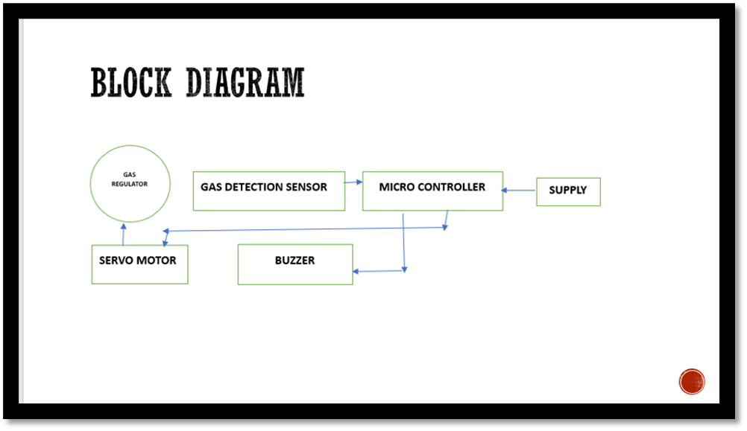
PROPOSED DIAGRAM

Slide 9
EXPLANATION OF PROPOSED DIAGRAM
We proposed to control the LPG regulator in automatically by means of microcontroller.
In proposed system we use the Arduino Uno to control the servo motor and gas leakage sensor. The rotating switch is act as a stove knob. It gives the indication to the controller whether the stove is on or off.
When the stove knob is turned on it gives the indication to the Controller and it give the signal to servo motor to turn on the Gas regulator knob with same angle. The open of gas regulator knob is 0 degree and close regulator knob is 140 degree.
The gas leakage sensor sense the gas leakage while turn off of gas regulator.

Slide 10
ADVANTAGE OF PROPOSED SYSTEM
It detects the leakage of gas flow
Fully automatic.
Turn off and On process of Gas regulator is safe and secure.
Minimum amount of frequent supply is enough.

Slide 11
RESULT
The working of our project is verified.
The sensor and servo motor perfectly working to control the LPG regulator knob.

Slide 12
FUTURE
. In Future Additionally we will add the pressure moniter to how much gas was consumed per day.
Gas consumption per day will displayed in the lcd display.

Slide 13
THANK YOU

